Slide 1

S-98 Meeting 11th December

Slide 2
Agenda
Introductions
S-164 update
S-98
Progress since Novermber
Forward plan
Comment Sheets / Issues
Submitted Comments
Other Contributions
AOB
Next meeting(s)

Slide 3
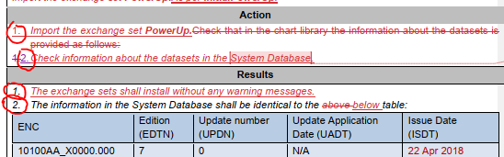
1. Manual review - Form
Tests are being updated with to adopt the new configuration worksheet.
Some inconscistencies to be fixed:
Terminology: « Load » vs « Import »;
« Chart Catalogue » vs « System Database », etc.
Inconcistecy betwen the announced and actual scale of the screenshots.
Inconcistencies in the content of « Setup » and « Actions » are being reviewed.
« Actions » and « Results » are being numbered for better understanding.
Suggestions to change some test (and Exchange Set) names to better fit with the actual test.
Most of this is inheritance from S-64 …
All is documented with comments in the manual.

Slide 4
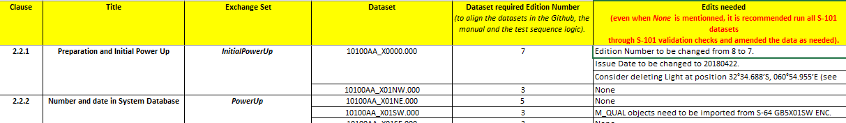
2. Manual - Content
All checks being reviewed and compared with available datasets.
A spreadsheet has been created to identify datasets to be created/edited.
Screenshots
Comments from OEMs are analyzed in parallel.
Some tests still need to be developed (Non ENC products).

Slide 5
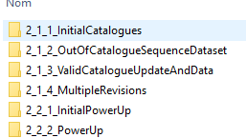
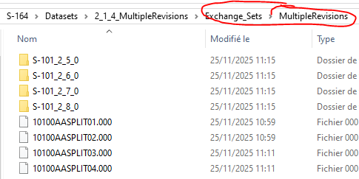
3. Github content
At this stage, the working structure of the Github may be confusing.
All needed exchange sets / datatest are stored locally with the final structure.
After being edited if needed, they will be imported in the Github.
60 open issues: most of them should be closed after the manual review or datset edits.

Slide 6
4. Way forward
Sections 1 and 2 have been fully reviewed.
Sections
Review completion by mid-January.
Dataset Editing / Creation in parallel
Manual and Exchange sets available for review by end of January.

Slide 7
Timescales
Following meeting 11th December, draft v2.5.0 to be completed (with inputs if required from PT members). PT can review and provide input for the v2.5.0 in that time as well.
16th Jan (or before), submission to S100WG for review
14th Feb – end of review and aggregation of comments
Comment adjudication up to March 17th
TSM (March 17th onward) to adjudicate any remaining comments and significant issues.
Post TSM version to be submitted to HSSC for approval as v3.0.0
Suggestion is to continue meetings through that time to assist implementers, answer questions and assess comments received to date.

Slide 8
S-98 Agenda Items [IN PROGRESS]
Agenda items
Issues from Github [JP]
Raytheon – outstanding comments [DS]
S-124
S-124 Section re-draft [Chair] [Alarms/Indications for NW]
S-124 / S-98 interaction [AU / AMSA]
Appendix D: ESC/WLA
Follow up TWCWG naming 104/111 / NOAA paper
Issues creating Enhanced Safety Contour [OSI]
Sun Illumination [Sperry Marine]
ENC + interoperabilityIdentifier
Interoperability identifier Use/definition and ECDIS behaviour [Chair / S-101 / NIPWG]
Highlighting and Pick Reports for common FOIDs in the viewport [Chair/S-101]
Area fills and centred symbol placements
S-101 – has anything been left out?
Miscellaneous topics
Numbers of products to be supported
Baltic Sea eNav [DK]?
CATALOG.XML attributes and Processing of cancellations
CATZOC algorithm modification proposal [FR]
Aboriginal languages in schemas [S-101]
AU – 12.10.2 vertical datum and D-3.5 is a repeat requirement.
What overlays what? Both options to be considered. Maybe for Appendix D only.

Slide 9
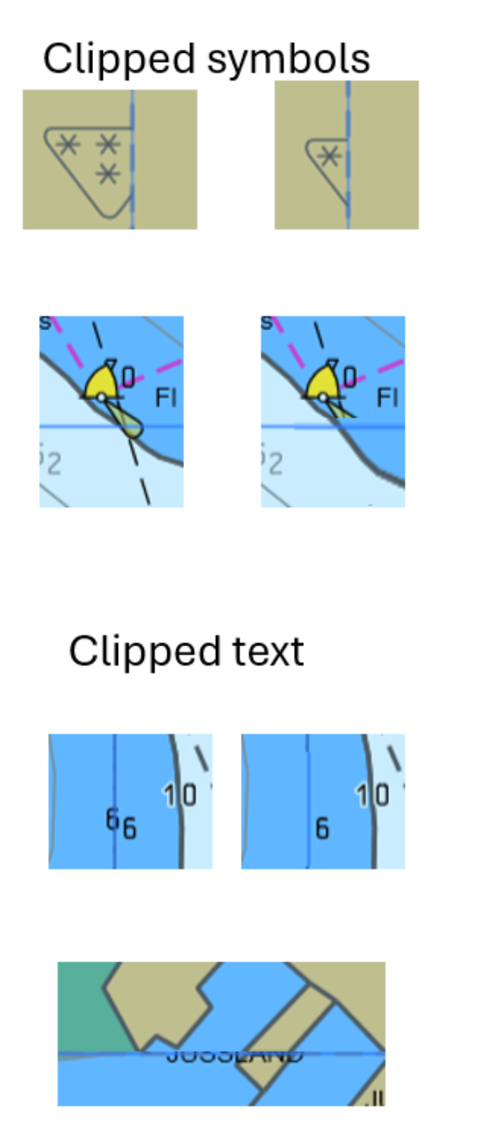
Issues
New issue on clipped symbols. Not covered by algorithm currently.
https://github.com/iho-ohi/98-interoperability/issues/73
Could a statement about OEMs ensuring symbols aren’t clipped be inserted?
Test data would then help implementers.
Other Issues:
Some dependencies on other PTs
Most will be documented and closed during redraft
Comment review period can cover outstanding issues.

Slide 10
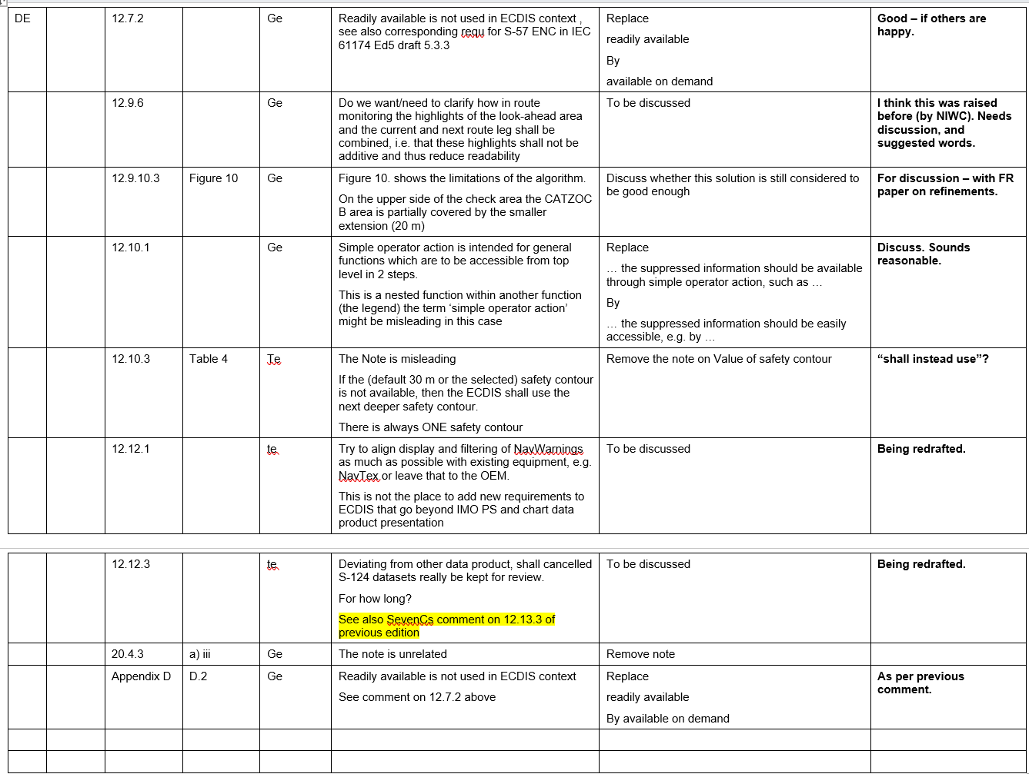

Slide 11
S-124 / S-98
2 VTCs on S-124 have been held.
Latest revision of words included in Github folder. Will be added to the S-98 2.5.0.
Next meeting on S-124 PT is 7th Jan. There is time to get outputs from there into the draft, ready for S-98PT to review.
Should there be an “alert” for new NWs as they are added to the system and they are on the current route [received from AU]. Comment for discussion

Slide 12
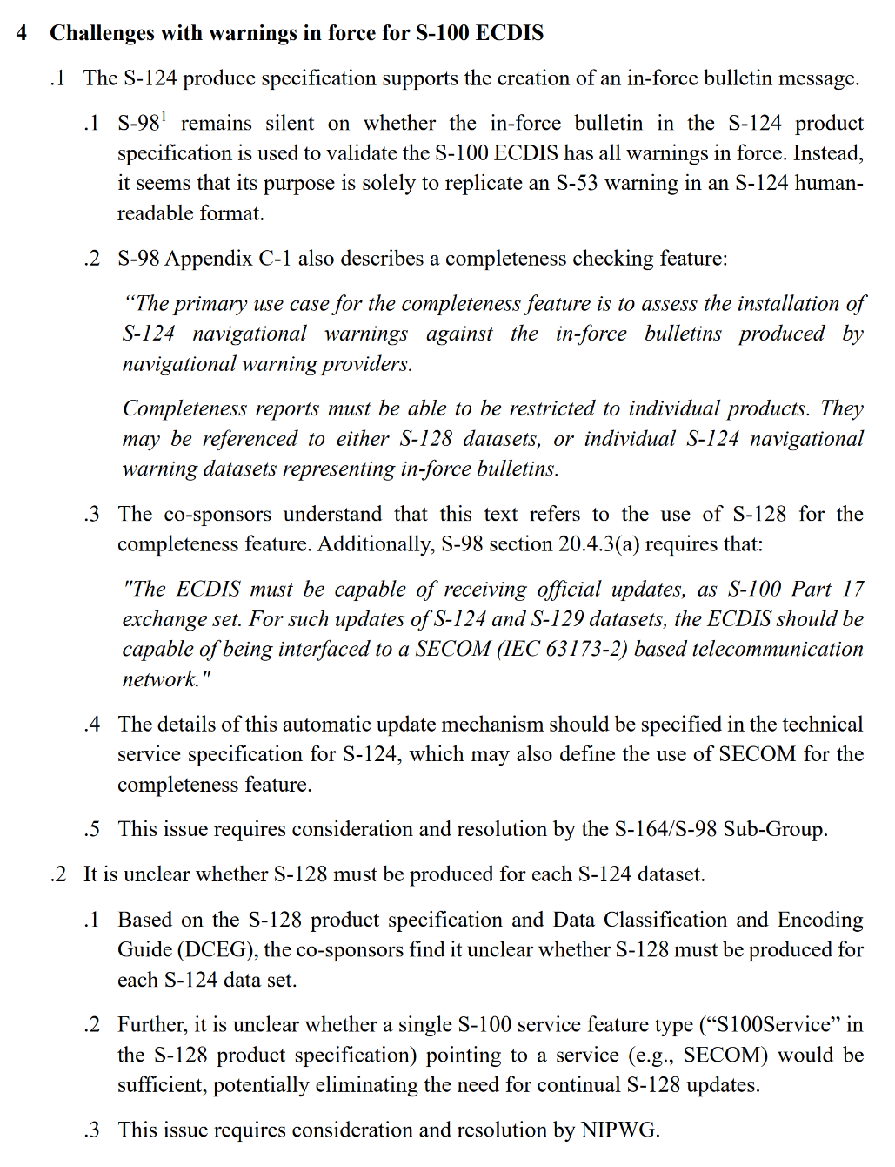
S-124 / S-128
Received from WWNWS via AU/AMSA
S-98PT is requested to help explain how the use cases/scenarios are handled.

Slide 13
Input on S-128 for S-124 completeness checks.
There are two options for ECDIS to perform completeness checks for S-124:
Using S-128
Using the S-124 In-Force Bulletin (IFB)
There is currently no requirement for an S-124 data producer to generate either of these.
SECOM could be used as an option, but cannot be required in S-98 since it is not mandatory.
From a data producer's perspective, supporting completeness checking would mean either:
Producing S-128 (or incremental S-128 updates) for every new S-124 dataset, or
Doing the same with S-124 IFBs.
The latter seems impractical, as IFBs already exist under S-53 and are typically issued periodically rather than after each new dataset publication.
Two possible alternatives:
Use the S100Service feature in S-128 to indicate that a dataset has been released by a “dynamic” service, rather than leaving its status as “Unknown” (see GitHub issue #40 (S-128)).
Add an optional requirement stating that SECOM may be used for completeness checking if implemented.

Slide 14
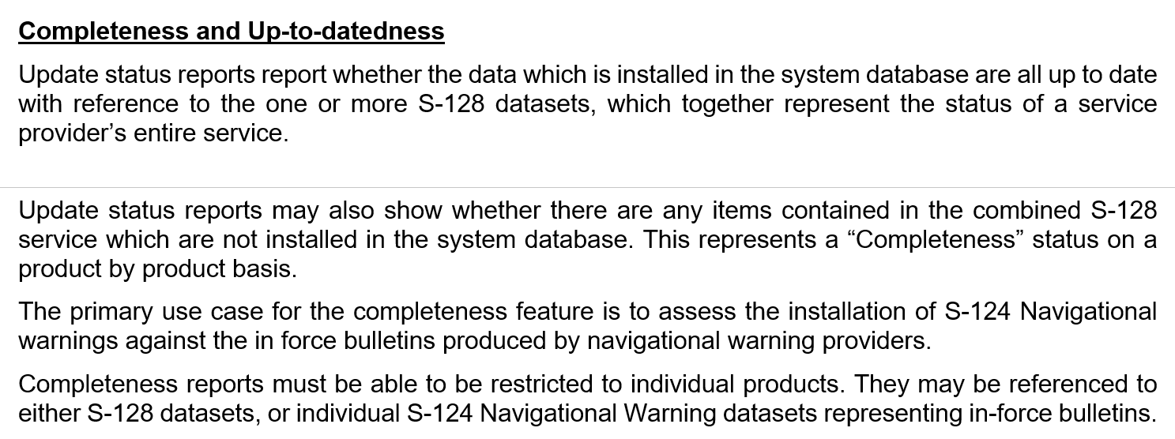
Completeness and Up-to-datedness
Update status reports report whether the data which is installed in the system database are all up to date with reference to the one or more S-128 datasets, which together represent the status of a service provider’s entire service.
Update status reports may also show whether there are any items contained in the combined S-128 service which are not installed in the system database. This represents a “Completeness” status on a product by product basis.
Completeness reports must be able to be restricted to individual products.
In the case of S-124, completeness reports may be referenced either to the relevant S-128 datasets or to an S-124 in-force bulletin dataset. The ECDIS must therefore be able to perform completeness checks using either S-128 or an S-124 in-force bulletin dataset, depending on which is provided.
If an S-128 dataset is available but does not contain references to individual S-124 or S-129 datasets, the ECDIS must, for datasets that would otherwise be marked as unknown, indicate that if the S-128 dataset contains an S100Service feature and the [producer code/producing agency] of an S-124 or S-129 dataset matches, the dataset have been issued under that service.
The SECOM GET SUMMARY functionality may also be used for completeness checking, if implemented (see section 20.4.3).

Slide 15
File Naming for S-104 / S-111
Actions:
Note and discuss the issues raised with the paper.
S-98 should devise a suitable mechanism and provide guidance for data servers to be able to distribute updates to S-104 and S-111 data sets without forcing the mariner to constantly generate new datasets and permits
Could wildcards in permits be considered? [NOAA/RM]

Slide 16
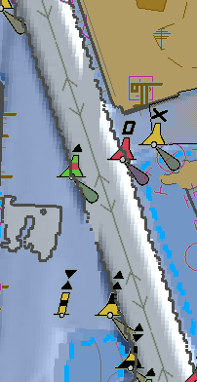
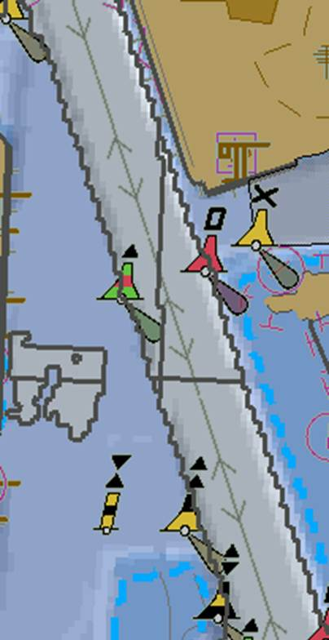
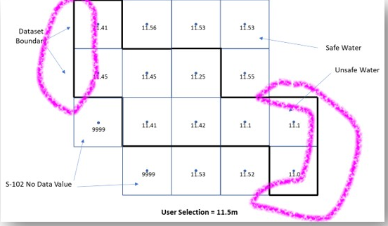
Enhanced Safety contour Issues [OSI]
In the current S-98 Appendix D, the safety contour must be drawn
Where you transition from safe to unsafe water (as defined by the values in the S-102 (+S-104 + uncertainty etc…)
At the edges of the dataset
Between NoData values and Data values.
This leads to a proliferation of safety contours.

Slide 17
Enhanced Safety contour Issues [OSI]
In the current S-98 Appendix D, the safety contour must be drawn
Where you transition from safe to unsafe water (as defined by the values in the S-102 (+S-104 + uncertainty etc…)
At the edges of the dataset
Between NoData values and Data values.
This leads to a proliferation of safety contours.

Slide 18
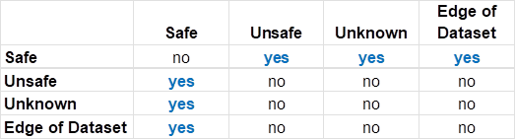
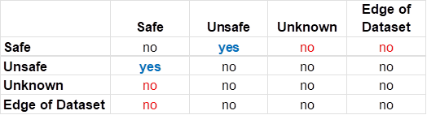

Proposal:
There are 4 cases (dataset regions), so 16 possible transitions (a->b) to consider.
Because A->B is the same as B->A and A->A is “obvious” there’s actually only 6 cases to consider.
These tables show the different possibilities
Current:
Proposal:

Slide 19
Proposal:
So, questions to resolve are:
Edge of dataset, can the ENC data be relied upon to determine safe vs unsafe (yes?)
Unknown (=Fill Value). Should it be assumed that the transition from safe->Fill Value is safe or unsafe?
Thoughts? S-98 can adjust either way.
The current model creates too many safety contours (“too safe”). We don’t want to change things to be “not safe enough”
This is relevant to the “holes” discussion
Dataset boundaries also need to be considered
Current:
Proposal:

Slide 20
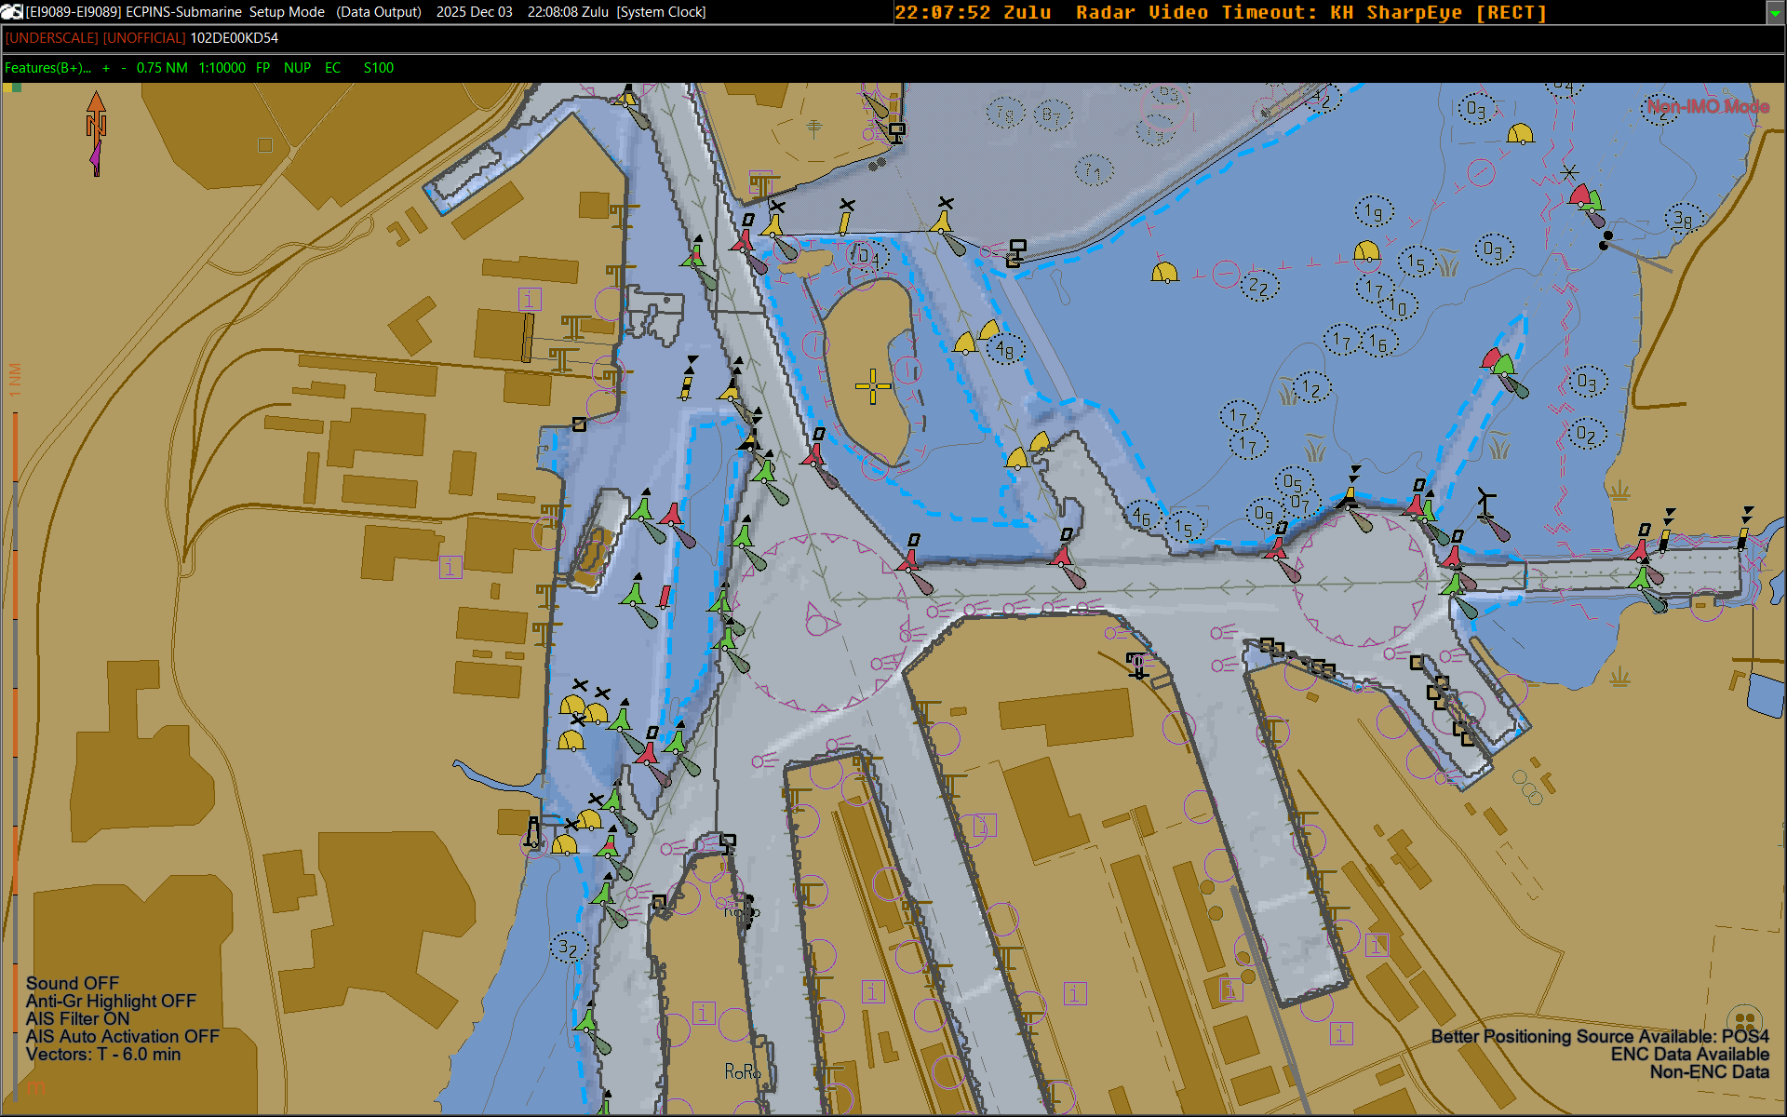

Slide 21
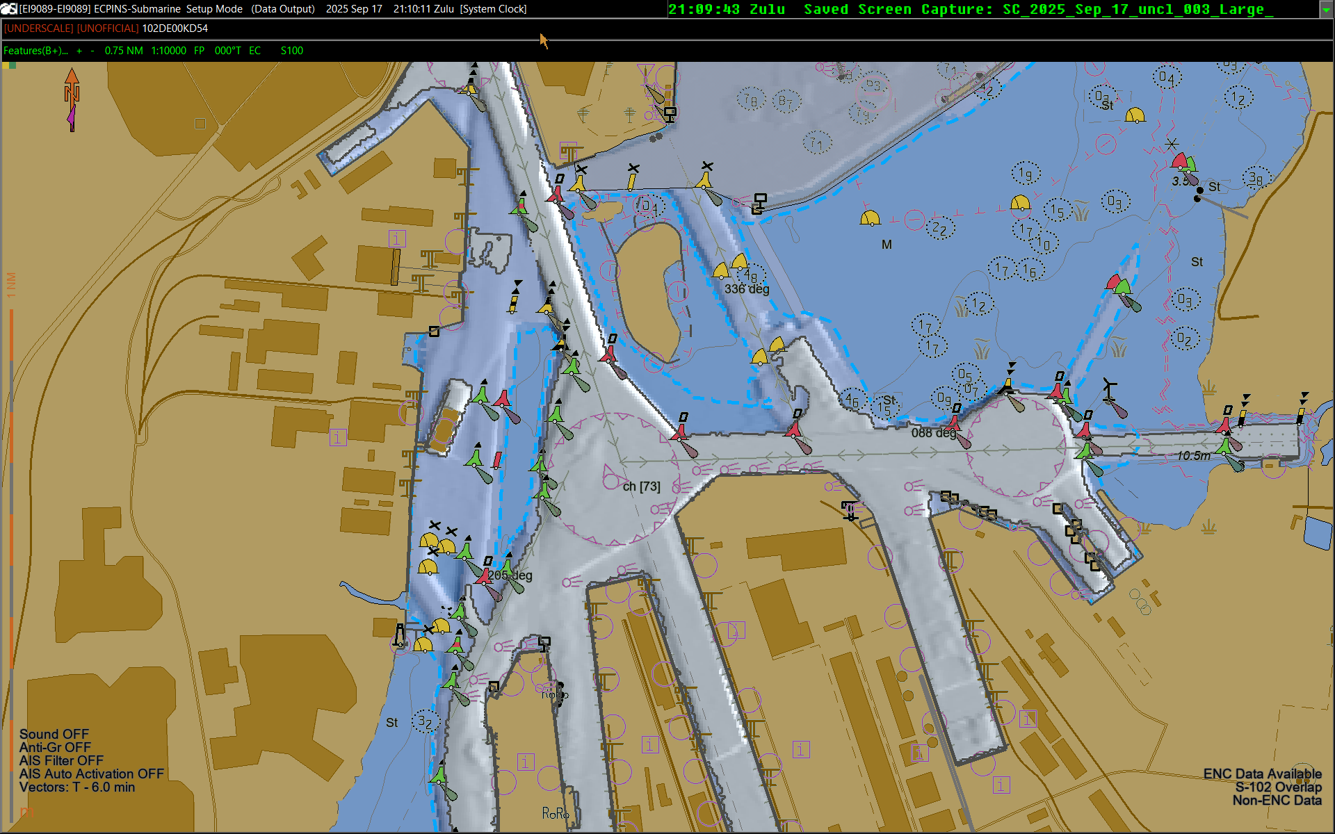

Slide 23
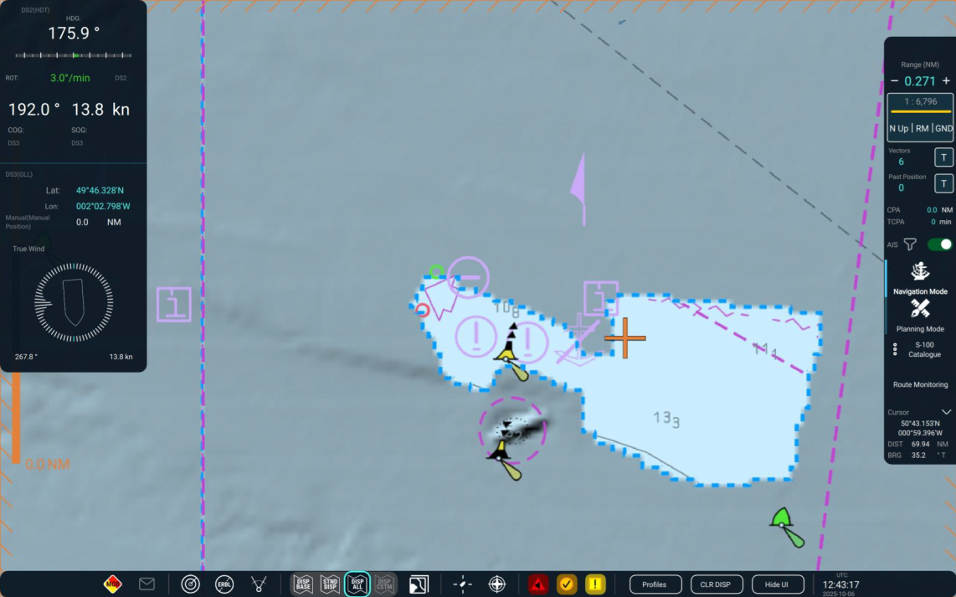
Sun Illumination text
Requirements for sun illumination were added to S-98 in clause 13.3.
However, it seems that these requirements perhaps should go further to ensure that S-102 data does not overlay key chart data.
Clause 13.3 states:
When S-102 is selected for use, in areas where S-102 coverage exists, the S-102 suppresses the drawing instructions associated with the following S-101 depth features
1. Depth Area
2. Dredged Area
3. Depth Contour
This also suppresses the safety contour, the shallow water pattern, the catzoc pattern, text indicating the dredged depth and contour labels.
The sun illumination implementation used for the sea trials may suppress more data than referenced in S-98 Ed 2.4 Appendix D.1. Since Appendix D.1 relates to Enhanced Safety contour only, and not to sun illumination, it seems that clause 13.3 on sun-illumination should be augmented to have the same overlay constraints applied to ensure that the sun-illumination does not inadvertently suppress important ENC information, as it appears to at present

Slide 24
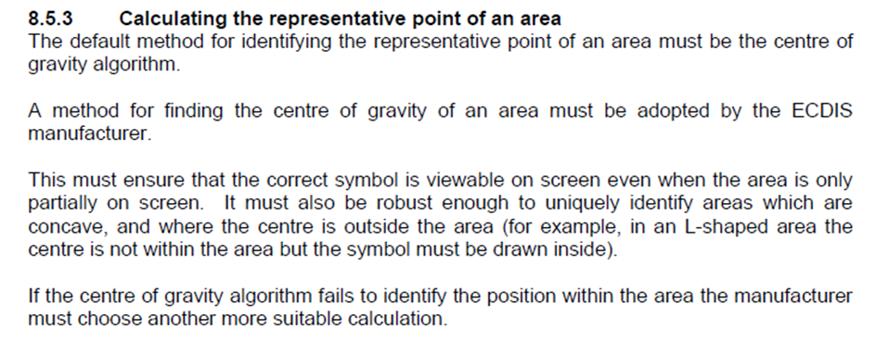
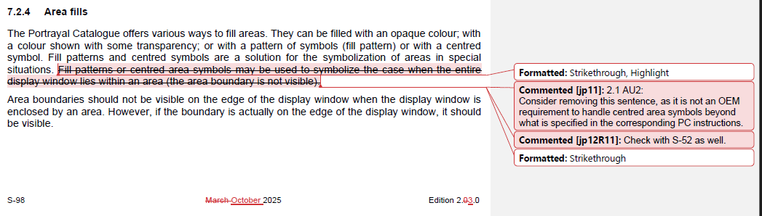
Area Fills Centred Symbols

Slide 25
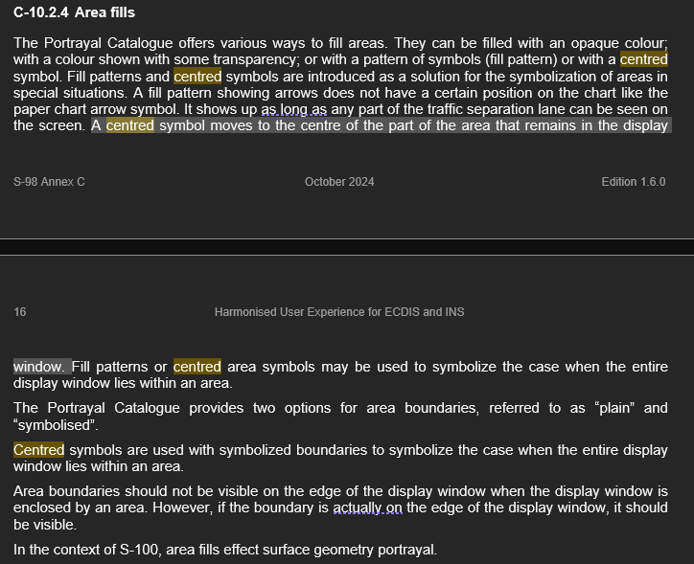
Area Fills Centred Symbols
Should the symbol get “recentred” to the visible part of the polygon by OEMs on the screen, or does the symbol drop off the display because the actual center point is now off the visible part of the screen and portrayal catalog has no way of knowing this?

Slide 26
S-101 and S-98
Is there anything else in the S-101 product specification that needs to be in S-98, anything for which a requirement needs to be placed on the implementer?
S-101 test datasets, functionality which isn’t an explicit “requirement”

Slide 27
Interoperability Identifier is ECDIS functionality. It is a “join field” providing interoperability across different product specifications – it says which features you want to be grouped together when one of them is picked by the pick report.
How does it work when you want the NW information to be returned when the user picks the bridge?
S-101
ENC₁
S-124
d
association
b
What happens when you do a pick report?
Which features do you get information for [a-d]?
Bridge
pick
a
Viewport
c
association

Slide 28
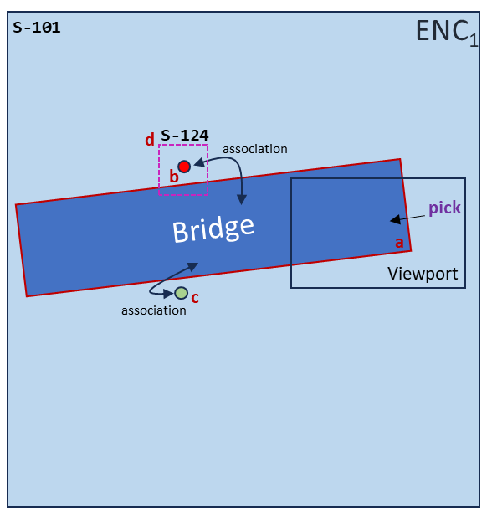
We are trying to do 2 different things:
Identify features (interoperabilityIdentifer does this)
Associate between features in different PS, (but also in different datasets (the same PS))
So
interoperablityIdentifier identifies “features”
featureReference.interoperabilityIdentifier contains a reference to “other” identifiers in some product specifications (not all)
The ECDIS must return (in the pick report)
All features with identical interoperabilityIdentifiers
Any feature which has a feature reference containing the interoperabilityIdentifier of the picked feature.
This works for the current S-124
There can be multiple feature references in S-124
How can you associate between different datasets (same PS) Using common foid?

Slide 29
The more complex case. When the bridge spans two different ENCs there needs to be a mechanism for providing interoperability across datasets from the same product specification
S-101
ENC₁
S-101
ENC₂
association
c
Viewport
b
Bridge
pick
a
foid=1810:238972:42
foid=1810:238972:42
d
association
What happens when you do a pick report?
Which features do you get information for [a-e]?

Slide 30
Features with common foids in the viewport should be merged together for the pick report?
S-101
ENC₁
S-101
ENC₂
association
c
Viewport
b
Bridge
pick
a
foid=1810:238972:42
foid=1810:238972:42
d
association
What happens when you do a pick report (a)?
Feature picked
Common foid
Associated with (b)
Associated with (b)

Slide 31
Miscellaneous topics
Miscellaneous topics
Numbers of products to be supported
Baltic Sea eNav [DK]?
CATALOG.XML attributes and Processing of cancellations
CATZOC algorithm modification proposal [FR]
Aboriginal languages in schemas [S-101]
AU – 12.10.2 vertical datum and D-3.5 is a repeat requirement.
What overlays what? Both options to be considered. Maybe for Appendix D only.

Slide 32
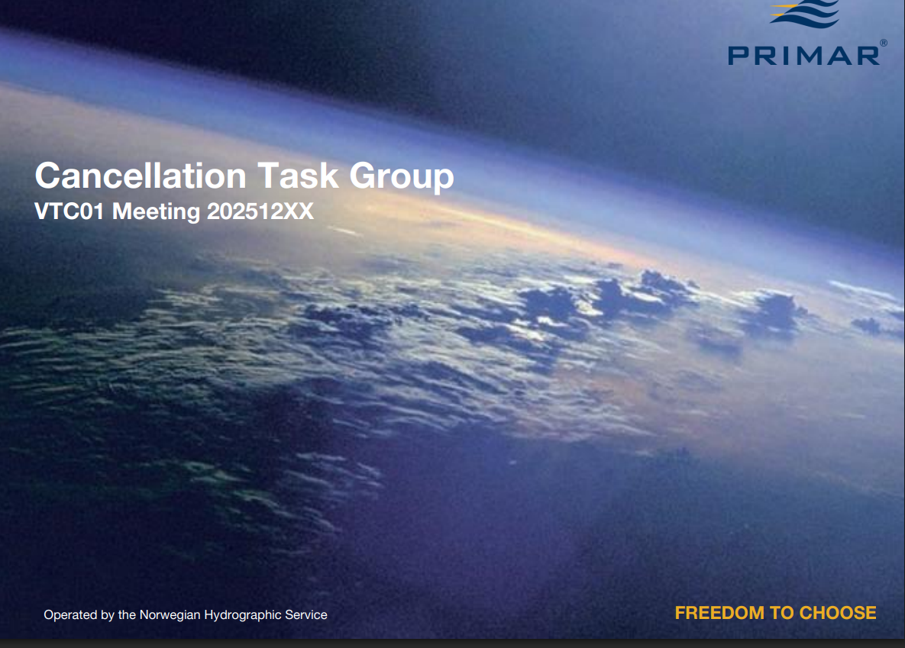

Slide 33
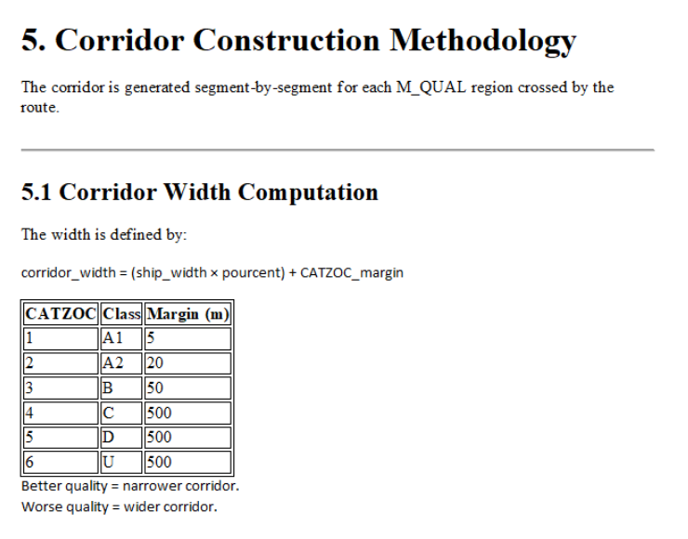
CATZOC / Data Quality [FR]
Paper received with refinements to the algorithm for taking into account CATZOC values
Needs evaluation, then consideration as a proposal for the algorithm currently drafted.
Test data and demo received.

Slide 34
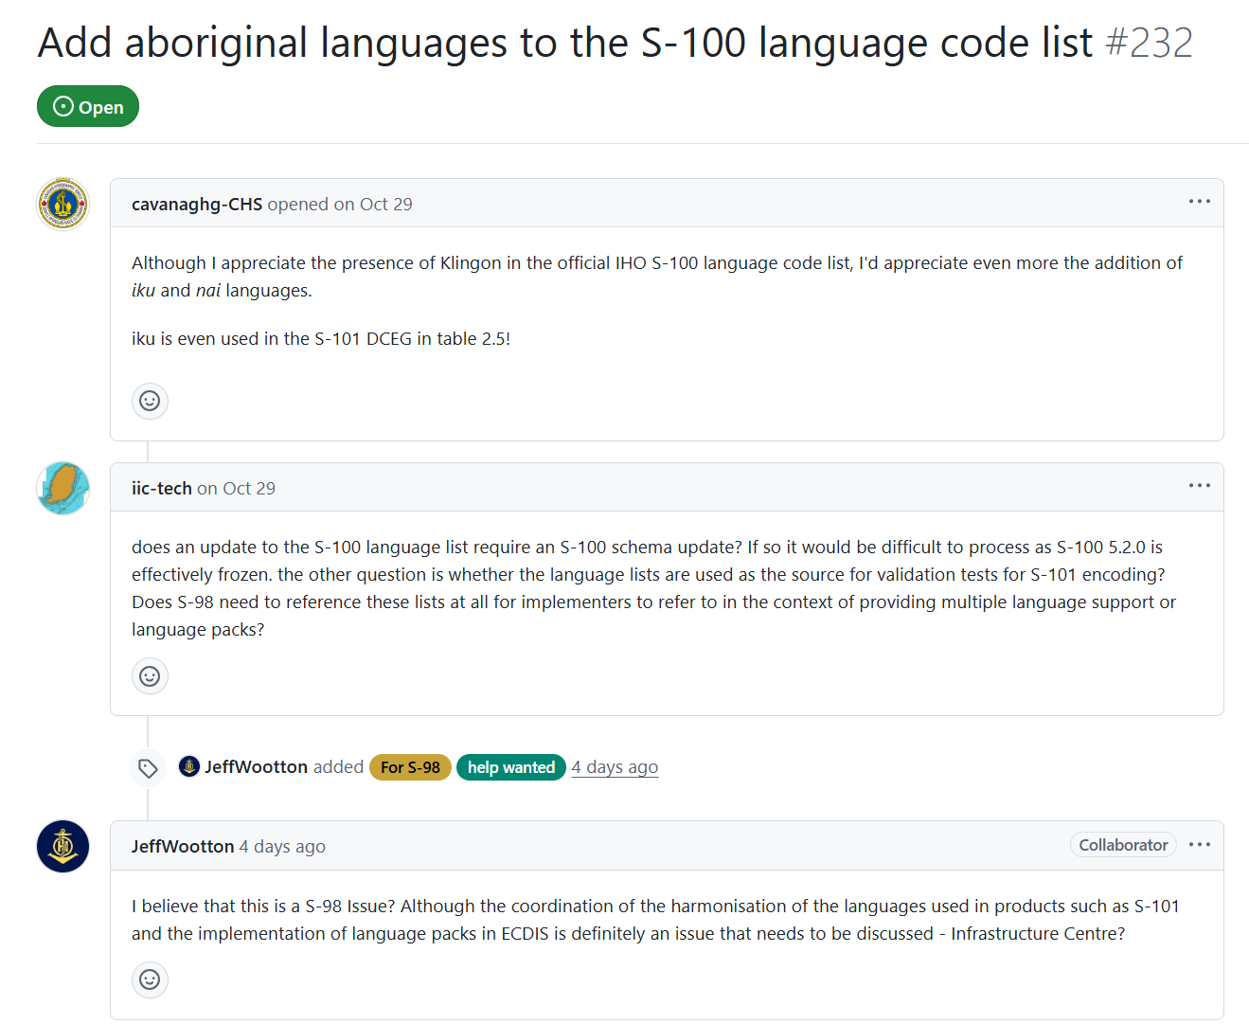

Slide 35
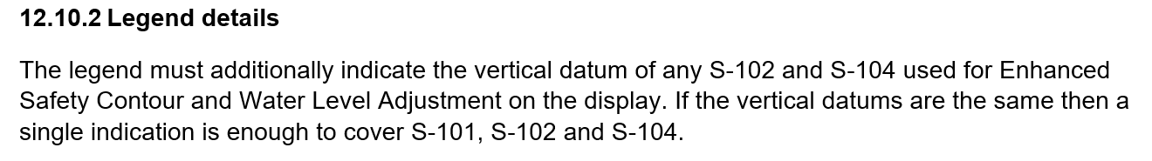
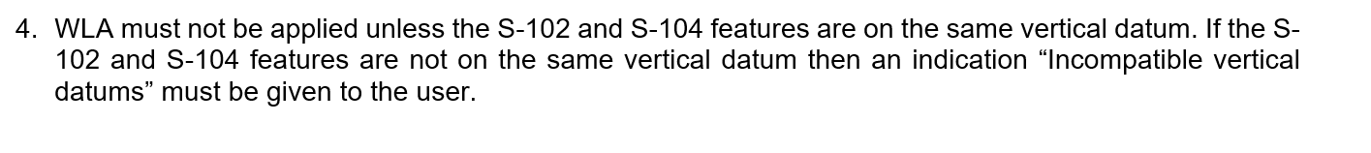
Duplication of requirements
Incompatible vertical datums
Cross-reference, and/or tidy up words.
Appendix D-1.2

Slide 36
Data Import Rules
When should data be loaded, and if it is, is it marked with the “non-official” border?
Current Rules – in S-98
All certificates must be “valid”, correct format and not expired
All certificates must be authenticated by the scheme administrator
All signatures must be valid. If they are not valid the dataset they sign must not be installed
All catalogues (Feature and Portrayal) must be signed by the Scheme Administrator to be installed
All datasets are marked with the unofficial border unless the role field in the certificate =
DATA_PRODUCER
DATA_AGGREGATOR (RENCS)
Dataset is S-128 and role=AGGREGATOR (distributors)
The “id” data producer integer and alpha code elements in the MRN of at least one of the authenticating certificates must match those contained in the dataset and its CATALOG.XML entry.
Is there still a requirement for “unofficial data” – we think so.
Should unofficial data installs be “warned about” using an SSE code?
Should there be a warning when it is used??
WEND WG – Proposal to cover “what overlaps what?”
Role = SCHEME_ADMINISTRATOR
SA Root Certificate
Subject=urn:mrn:iho:GB00:00540
(DS) Certificate
Issuer=IHO
Role=DATA_PRODUCER
Signature
Dataset
id=GB00,00540

Slide 37
Data Import Rules Proposal
(Add to current rules in S-98)
All ENC Data is loaded according to the algorithm (Appendix E)
Non-ENC Data is only used (portrayed/processed) when MSVS is between the values specified in CATALOG.XML for minimumDisplayScale and maximumDisplayScale
Propose to add to this:
Non-ENC data must only be portrayed over ENC data if:
The data producer of the Non-ENC data is the same as the data producer of the ENC data; or
The ECDIS has imported a certificate issued by the ENC producer with the Non-ENC data producer as its Subject.
Possibly restrict this only to ESC/WLA?
Role = SCHEME_ADMINISTRATOR
Role = SCHEME_ADMINISTRATOR
SA Root Certificate
SA Root Certificate
id=urn:mrn:iho:GB00:00540
id=urn:mrn:iho:GB00:00540
Certificate
Certificate
role
role
Signature
Signature
ENC Dataset
id=XY00,00378
Non-ENC Dataset
id=AB00,00493
overlaps
Subject=urn:mrn:iho:AB00:00493
Certificate
Issuer= urn:mrn:iho:XY00:00378
Role=DATA_PRODUCER

